Slide 1
A Hybrid ARIMA & SVM Model For Stock Price Forecasting
Jason Arrabito

Slide 2
Proposal
For our group project we chose to replicate the hybrid ARIMA and SVM model presented in A hybrid ARIMA and support vector machines model in stock price forecasting and proposed by Ping-Feng Pai and Chih-Sheng Lin. This project focuses on two machine-learning methods: the ARIMA model and the SVM model. We will analyze the data sets of twelve companies, but not the same that were presented in this paper.

Slide 3
Period
The data Analyzed is from twelve recognizable stocks from the date May 18, 2009 to September 3, 2009.
The time period was chosen because of the possible market volatility after the 2008 financial crisis.
Using the formula for a Hybrid Model presented we were able to replicate similar results.
We used daily closing stock prices and the WEKA data analysis software.

Slide 4
Method
In order to more accurately model the data in correlation with that of Feng-Pai and Lin we had to use an older verion of WEKA (3.7.9) that allowed for the use of the time series linear regression package to model the ARIMA method. The SMOreg package was used to model the SVM method for predictions on a training set for the vector weights.
In total there were 77 data points. The first 40 data entries were used for training and the remaining 37 were forecasted.
The ARIMA model used 1 step-ahead prediction method.
For the SVM the correlation coefficient was 0 when modeling the data initially and was 1 when modeling the residuals for the Hybrid Model.

Slide 5
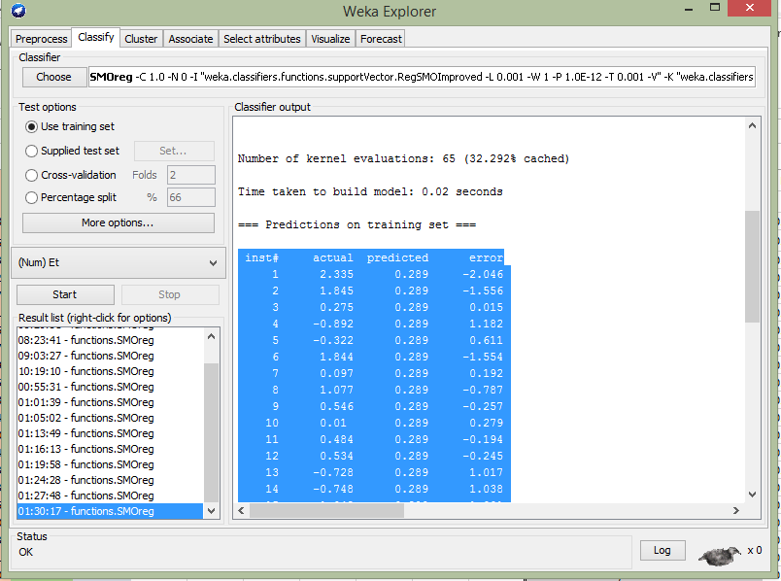

Slide 6
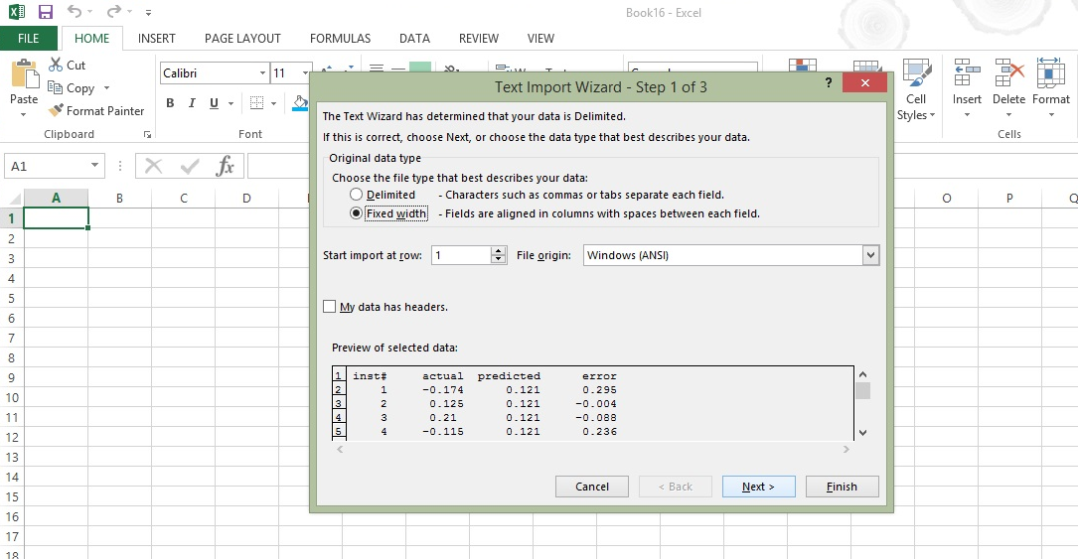

Slide 7
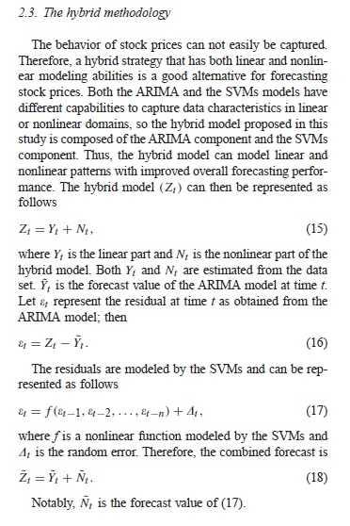
For the Hybrid Model we first estimate Yt and Nt using ARIMA and SVM respectively. We then subtract the forecasted data values for each time slot, represented by Ỹt, from the estimated value Zt which represents Model 3. The residuals are then modeled by the SVM. Adding the modeled residuals to the random error at time t gives us Ñt. Using the linear and the non-linear components together we get the Hybrid Model.

Slide 8
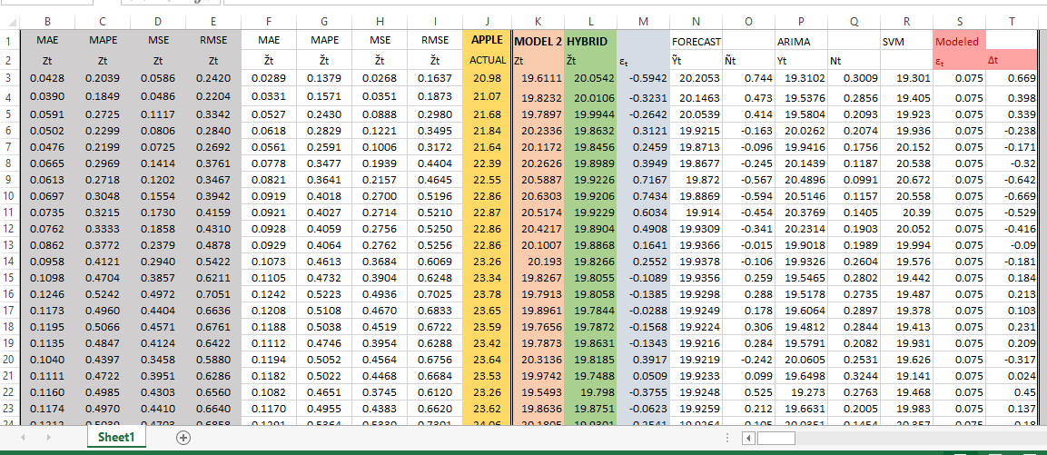

Slide 9
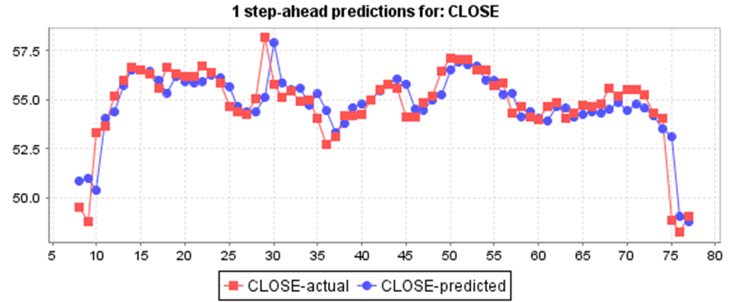
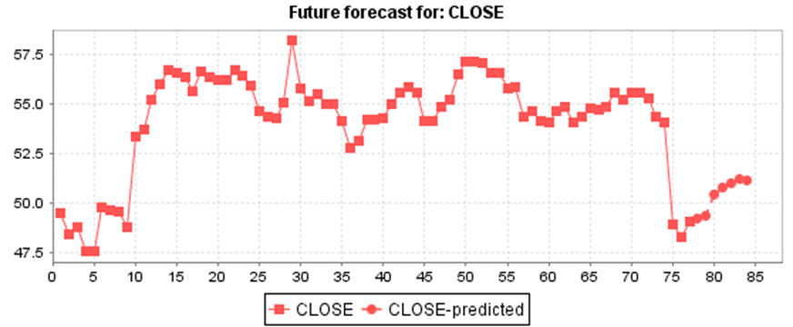
COKE

Slide 10
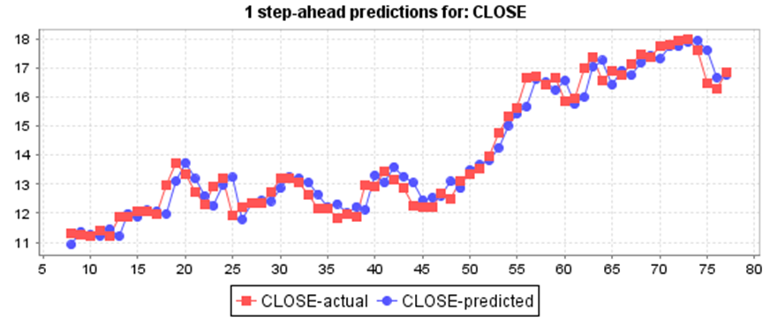
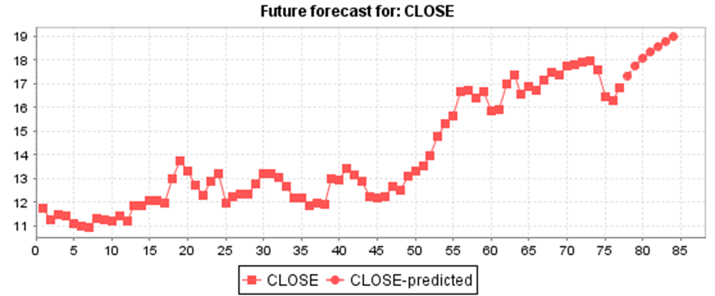
Bank Of America

Slide 11
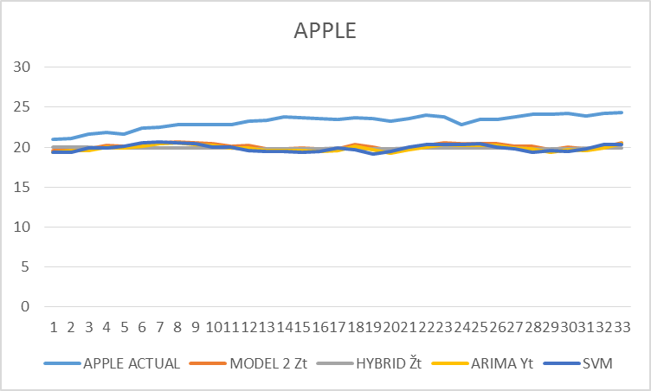
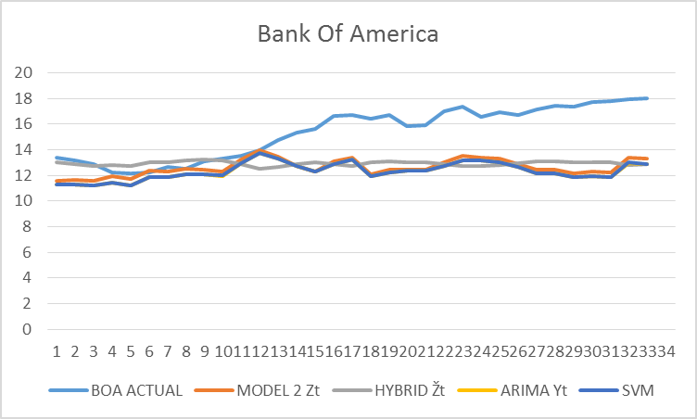
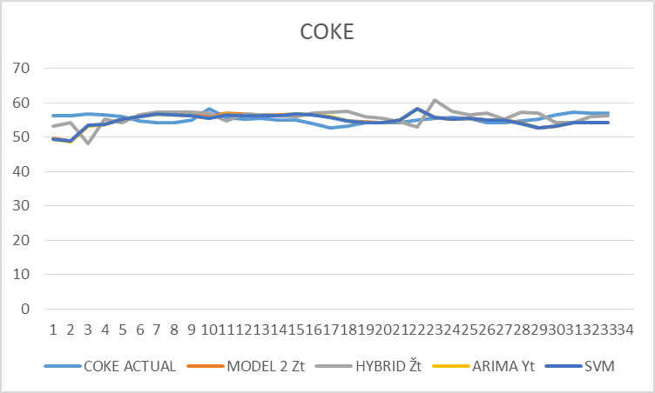
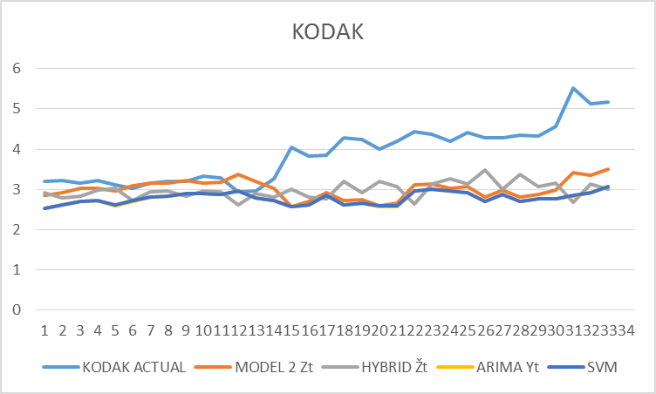

Slide 12
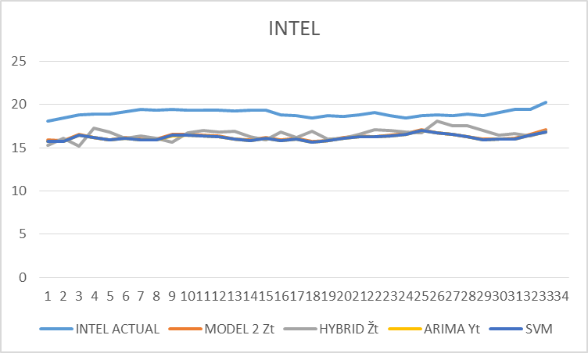
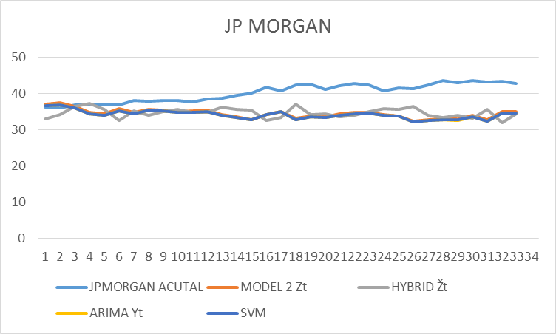
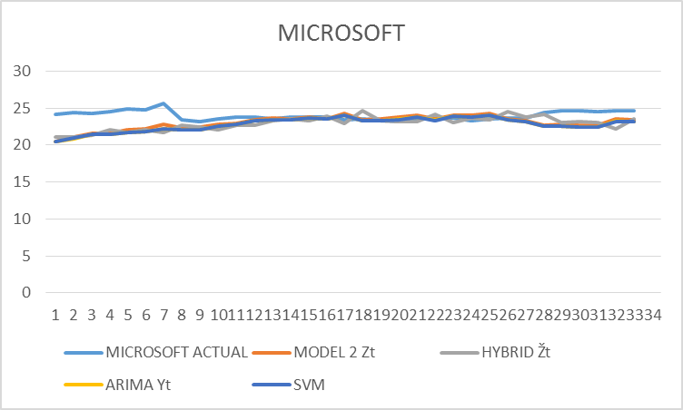
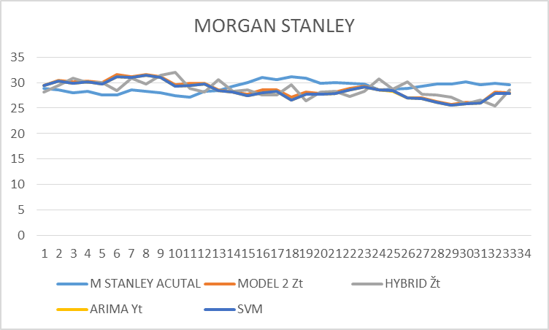

Slide 13
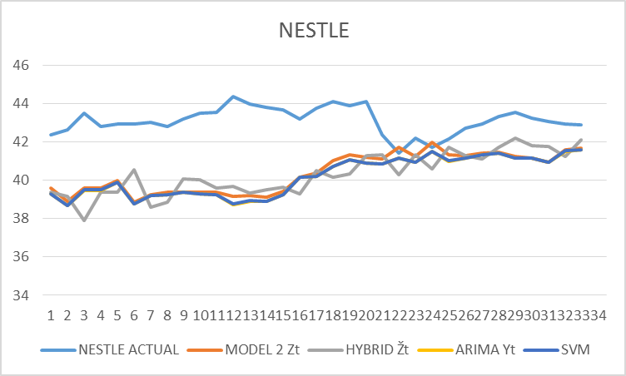
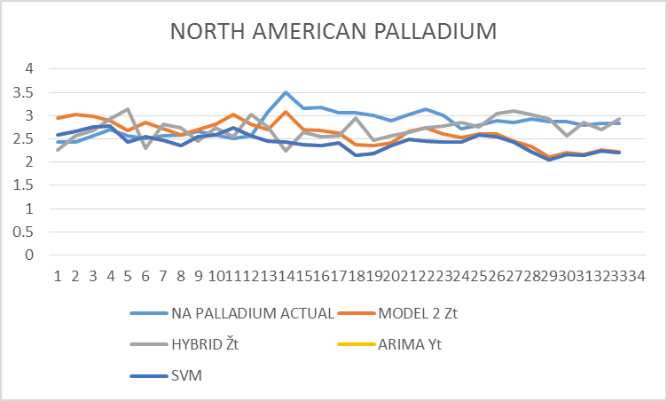
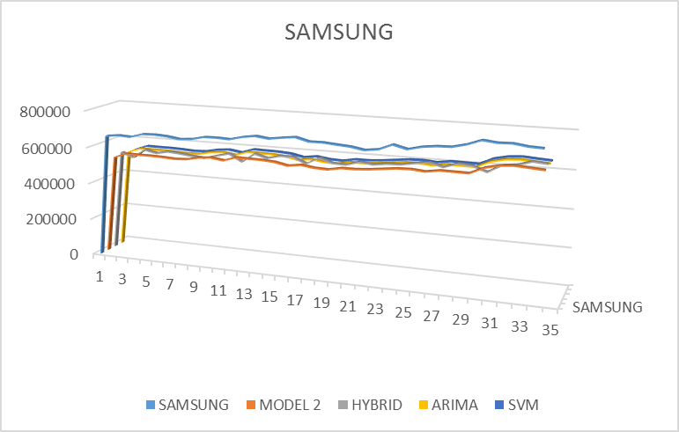
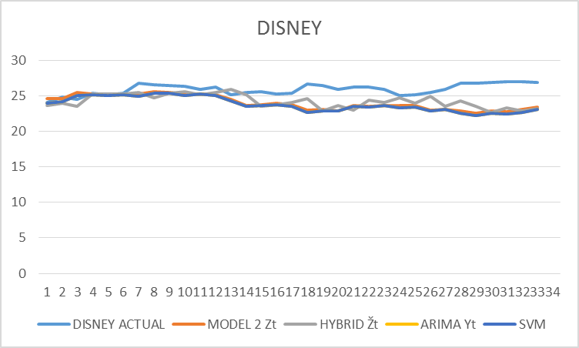

Slide 14
RESULTS

Slide 15
RESULTS

Slide 16
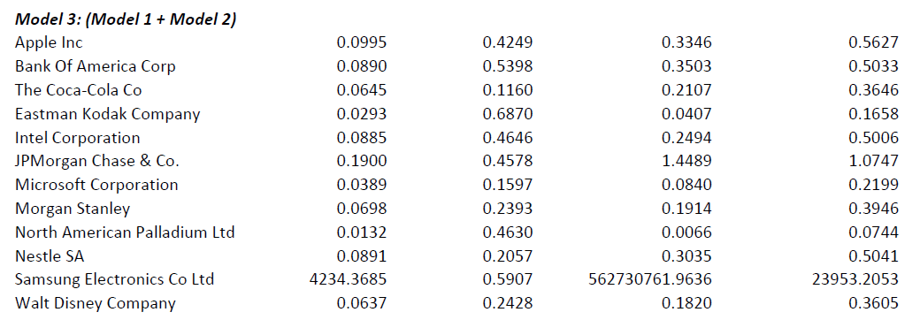
RESULTS

Slide 17
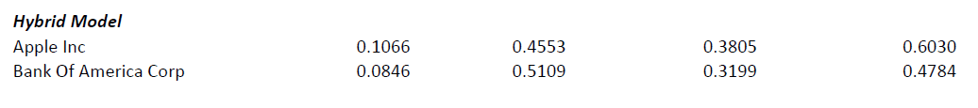
RESULTS

Slide 18
CONCLUSION
The initial trial represented in the paper by Feng-Pai and Lin showed greater results for the Hybird Model over all. This is likely due to a period of time with much less volatile stock prices and more accurate ARIMA and SVM modeling, which was likely done with more advanced software. With our model Apple, Coca-Cola Co., and Microsoft were predicted better with Model 3 than the Hybrid Model, while all others benefited from the Hybrid Model with the exception of Nestle which was roughly equal in both cases.
In general both models outperformed the ARIMA model.
With SMOreg package were we unable to report MAPE and MSE and MAE and RMSE are reported completely off scale. In hindsight it we see that WEKA was reporting error for the weights.

